Slide 1
Online Learning at Witt
A workshop for faculty teaching in summer – part I
Please sit in groups of no more than four people

Slide 2
Bryce Holland
ProStratus IT Project Manager
hollandb@wittenberg.edu
937-525-3807
Wittenberg ITS Solution Center
solution@wittenberg.edu
(937) 525-3801
Barbara Randazzo
GPS Executive Director
randazzob@wittenberg.edu
937-327-7040
Michelle Van Dyke
GPS Director
gaffordm@wittenberg.edu
937-327-7015

Slide 3
Agenda
Online Summer School Information
Review of Moodle Basics
Campus Resources
Essential Info for every Moodle Course
Best Practices in beginning Course Design
Instructional Equivalencies
Accessibility

Slide 4
Why Online Classes Matter
Summer 2018
375 students
61 total classes + 23 independent studies + 22 internships = 2,232 credits
34 online classes = 42% overall credits
Online courses have historically yielded a significantly higher average enrollment than traditional classes and out-of-class offerings.
Summer 2019
68 total classes scheduled
34 online classes
We continue to believe that the best strategy for growing summer enrollments is to deliver quality online offerings of more traditionally high-demand courses to meet the needs of students who, in addition to taking classes, plan to work and/or return home over the summer.

Slide 5
EPC Questions for Online Learning
Does the course normally rely on discussion, group activities, and other engaged learning practices? If so, how do you intend to approximate that aspect of the class online?
How will you monitor and assure academic integrity in the online course?
How will you make yourself accessible to students for course assistance and advice?
How will you enable and encourage student participation and engagement in the online class?

Slide 6
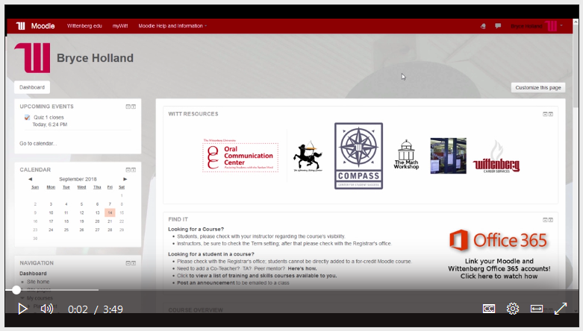
Orientation Email & Video Help for Students Taking Online Summer Classes
FYI: You are registered for an online summer course!
How to log in to Moodle and find your summer course
Video introduction tutorial
Who to contact for help
Add/drop dates
Academic Honesty Policy

Slide 7
Bryce Holland
Masters of Education (Educational Technology)
Taught Eight Years for Grades 7-12
Taught Professional Development and Online Learning
Earned APPQMR Certificate (Quality Matters)
Used Moodle Since 2006

Slide 8
Review of Moodle Basics
Course Layout Tips (Weekly or Topics)
Course Settings
Course Blocks
Assignment Types
Announcements Forum

Slide 9
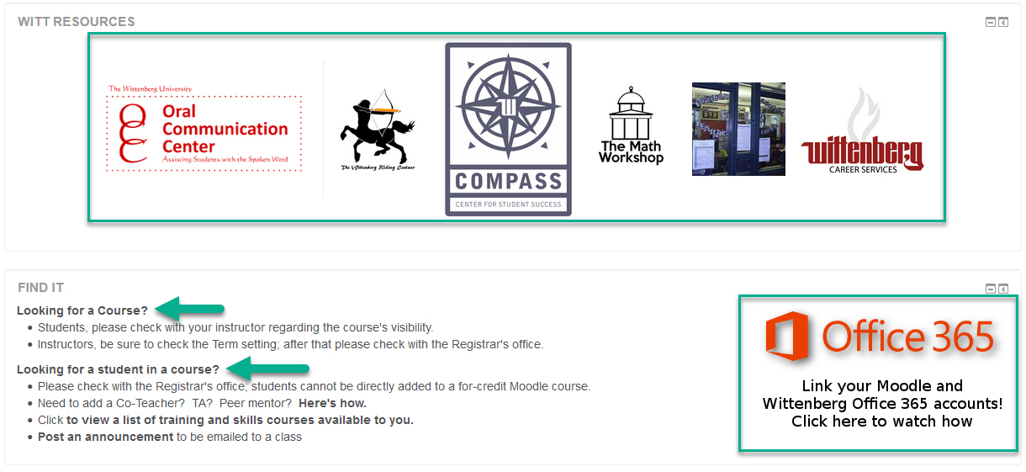
Campus Resources - Moodle

Slide 10
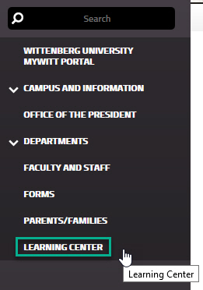
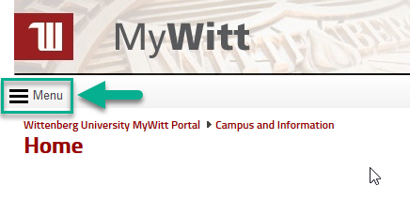
Campus Resources - MyWitt

Slide 11
Barbara Randazzo
Master of Science (Leadership and Business Ethics)
Teaching since 2009
Successful completion of Online Faculty Assessment, July 2013
Developed and instructed courses in the online, on-ground and blended formats
Have developed Master Courses and adapted classroom to online and blended formats
New to Moodle! (Blackboard and Canvas background)

Slide 12
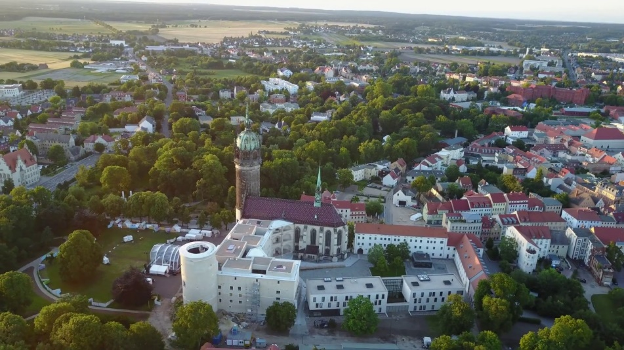
Essential Info for every Moodle Course
Course/Weekly Overviews
Thomas Library Link
"I affirm that my work upholds the highest standards of honesty and academic integrity at Wittenberg, and that I have neither given nor received any unauthorized assistance."

Slide 13
Professional Educators

Slide 14
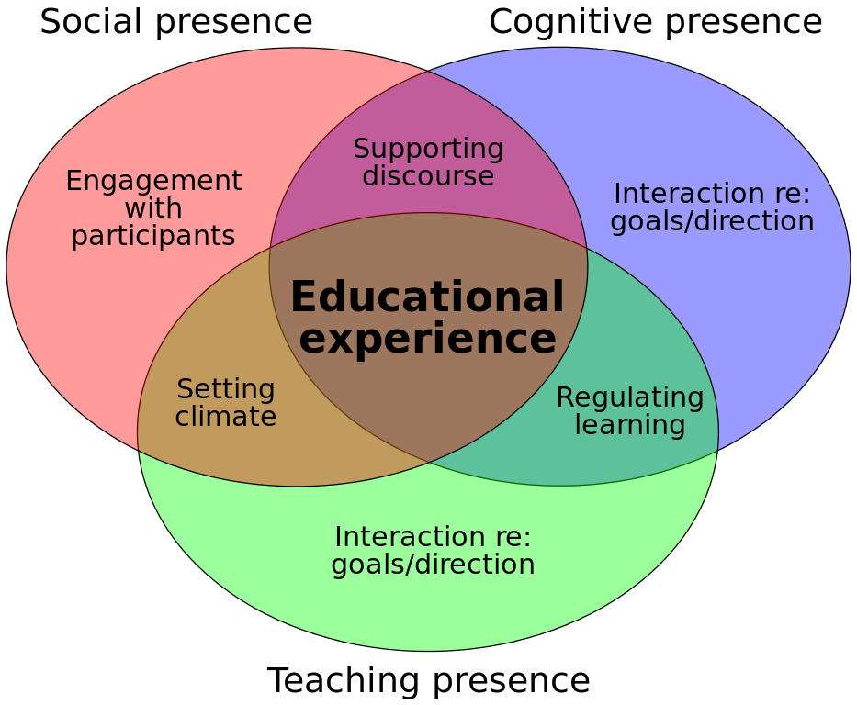
Community of Inquiry Framework

Slide 15
Social Presence

Slide 16
Cognitive Presence

Slide 17
Teaching Presence

Slide 18
Reference
Garrison, R. D. (2017). E-Learning in the 21st century a community of inquiry framework for research and practice. New York: Routledge.

Slide 19
Group Activity: When Does Learning Stop?

Slide 20
Best Practices in Beginning Course Design
A "Start Here" Graphic
Instructor Intro via picture and text or video
Clean design and visual flow
Student "Ice Breaker" activity --> what tools in Moodle could be used?
"Ask the Instructor" forum for class questions
Clear and easy access to course syllabus and instructions
Weekly (or by topic) instructions and overview
Diversity of course activities and resources

Slide 21
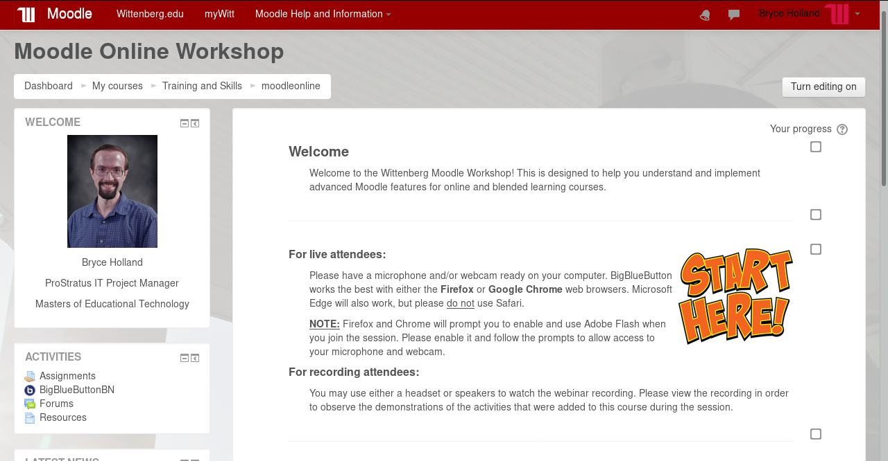

Slide 22
Group Activity: Moodle Critical Thinking?

Slide 23
Regular and Substantive
“Distance education means education that uses one or more of the technologies listed in paragraphs (1) through (4) of this definition to deliver instruction to students who are separated from the instructor and to support regular and substantive interaction between the students and the instructor, either synchronously or asynchronously.”
Higher Education Opportunity Act, Aug 14, 2008
https://www.govinfo.gov/content/pkg/PLAW-110publ315/pdf/PLAW-110publ315.pdf

Slide 24
Regular and Substantive
Regular and substantive, from Dec 2014 Dear Colleague Letter:
“Participating in regularly scheduled learning sessions (where there is an opportunity for direct interaction between the student and the faculty member);
Submitting an academic assignment;
Taking an exam, an interactive tutorial, or computer assisted instruction;
U.S. Department of Education Dear Colleague Letter (December 2014)

Slide 25
Regular and Substantive
Dear Colleague Letter (cont.)
Attending a study group that is assigned by the institution; Participating in an online discussion about academic matters;
Consultation with a faculty mentor to discuss academic course content; and
Participation in faculty-guided independent study.”
U.S. Department of Education Dear Colleague Letter (December 2014)

Slide 26
Regular and Substantive
Dear Colleague Letter (cont.)
“Substantive does NOT include:
Computer-generated feedback on objective assessments
Recorded webinars, videos, and reading materials if the course design materials did not require the students to watch the webinars and then interact with an instructor.”
Contact with mentoring staff who are not directly providing instruction on the course’s subject matter.”
U.S. Department of Education Dear Colleague Letter (December 2014)

Slide 27
Defining “interaction”
Must be instructor-initiated
“Regular”
More than just a grade / relevant to subject matter
Accredited faculty member
2015 DOE Federal Student Aid conference: Slides 27-32

Slide 28
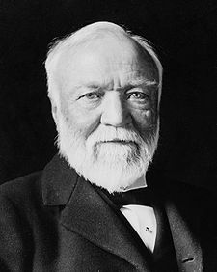
Wittenberg Instructional Requirements for all courses:
Minimum Contact | 1 cr class | 2 cr class | 4 cr class
Minutes | 750 | 1500 | 3000
Hours | 12.5 | 25 | 50

Slide 29
Determining Instructional Equivalencies
Step One
Review course learning outcomes
Ensure all assignments are aligned to an outcome and all outcomes are accessed
Commit to utilizing a mix of instructional tools and techniques

Slide 30
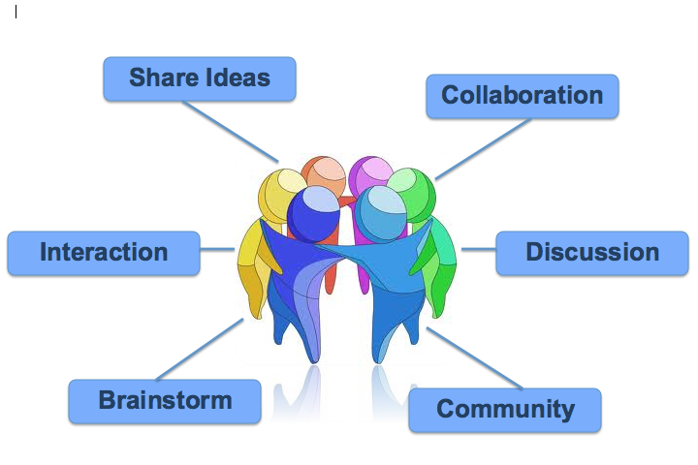
Determining Instructional Equivalencies
Big Blue Button – synchronous & led by instructor
Weekly Discussion Boards w/student posting expectations & faculty participation
Student groups w/ expectations for reporting out
Muddiest topic discussion board
Each One Teach One
Weekly due dates
Video content w/ instructor/student engagement
Field trips
Interviews
Blogs, journals
Web search activities
Recorded lectures (in smaller time increments)

Slide 31
Accessibility
Headings in Text Editor
Alternate Text for Images
Embed YouTube Videos with Closed Captions Enabled
Instruct Students on How to Use any Required Technology for the Class
Be Willing to Use Time in the First Class for that Technology Instruction

Slide 32
Open Lab Work Sessions w/Bryce
If you would like live assistance with building your Moodle course, Bryce will be available in the Thomas Library Computer Lab during the following days/times:
Tuesday 2/12 11:00am – 1:00pm
Friday 2/15 2:00pm – 4:00pm
Tuesday 2/19 11:00am – 1:00pm
Friday 2/22 2:00pm – 4:00pm
Bryce is also available for one-on-one help via email and/or appointment.

Slide 33
Questions???
Faculty workshop part II:
how to introduce faculty voice
use of Big Blue button for synchronous sessions
plagiarism prevention
More Online teaching tools and techniques

