Slide 1
Hagen Center Civic Internship Program 2023
Site Information Meeting
Notes:
Thank you for your interest
Welcome and Introductions- if new, why interested and if returner, share a highlight
Excited to be coordinating program
Will keep several things and add in some new improvements
Packet
PowerPoint
Overview of Internship- sent with email/proposal link
Proposal- draft
Learning contract
Guidance on writing and selecting

Slide 2
Purpose of Internship
The program helps students gain the knowledge, skills, and dispositions to be actively engaged citizens in their community.
We are looking for partners with a community-focused mission interested in providing students a project-based and experience-oriented opportunity that helps them further their personal, professional, and civic goals.
All internship positions must give the student meaningful opportunities to contribute to the Greater Springfield community while increasing the organizations capacity to fulfill its mission. Typically, summer partners are non-profit or public sector organizations.
Notes:
Looking for internship that foster student’s civic skills, but also make a meaningful contribution to your organization.
Mutually beneficial!
And, of course get to work alongside servant leaders in our community.
To help with the fostering of civic skills, have you fill out Learning Contract

Slide 3
Internship Dates
Tuesday, May 30th - Thursday, June 1st:
Student interns attend the Hagen Center’s mandatory orientation
Friday, June 2nd - Friday, July 28th:
Students intern with community partners
Last week of internship: Internship Celebration
Notes:
These are the dates for this year, just a bit longer into July than in the past, finding several sites needed help until end of July.
They all start with us, and then start with you on June 2nd.
Then we all celebrate together the last week, will work on a specific date/time as we get closer to the summer (gallery/lunch)

Slide 4
Overview of Internship
Although hours may vary, student interns are expecting to work 37 hours a week, and they cannot go over 37 hours during a weekly pay period.
Students are paid $10.25/hour, and the community partner will be billed monthly to cover their agreed to wages.
~$3000 is needed to cover wages (limited funds are available to cover half, or in rare cases, all of this cost for organizations unable to support an intern). If you request an intern for longer than the established dates of the internship, it will affect the total cost of the internship.
The Hagen Center covers housing during the established dates of the internship and additional costs associated with the program such as orientation, weekly gatherings, and the final celebration. Students will have to cover the cost of housing needed before or after the internship.
Notes:
We are asking for 20 internships that offer ~37 hours/week (and no more, those are the Wittenberg student employment guidelines)
And, the pay is $10.25, again based on our tiered funding levels at Wittenberg for students (and some may want internship credit)
PERK- The students are all paid through our student employment payroll, and sites are invoiced for hours worked.
So, if a site pays the full amount for an intern, it will be about $3000 for the 8 weeks.
We do work to try and provide funding, in past have been able to cover ~3 internships at 100%, ~8 at 50%
We will look at all the internship submitted and have a review process and determine who we can fund, and at what level.
PERK- We will cover housing for the dates internship and the student wage costs for the Hagen Center orientation.
Students will be responsible for housing needed before or after internship dates, sites will responsible for wages before or after internship dates.

Slide 5
Selection Process
Due date for submitting a proposal is Wednesday, February 1st by 5pm.
Community partners will submit an internship proposal, and if selected, will be asked to confirm participation by February 10th.
By March 3rd, students will apply for the internships in Handshake (Wittenberg’s job posting platform) and the Hagen Center will email all application materials to the site supervisor.
Community partners will be responsible for reviewing applications, scheduling interviews, and notifying us of their final selection by the end of March.
In April, we will ask supervisors to attend a mandatory site supervisor meeting and sign a partnership agreement.
NOTE- Although we will promote your position, we are unable to guarantee that a student will have the availability, interests, or requirements that match your needs.
Notes:
Due date to submit proposal is February 1st, again email sent out by 2nd week of January
We review proposals and be in touch by February 10th to let you know if you have been selected, and then we will ask you to confirm participation
By February 16- announce to students, host interest meeting (required to apply)- and 2.5 gpa, any major
We will post all positions in Handshake
Once we post positions, students have approximately three weeks to review, prepare and apply to positions through Handshake.
We will send you list of applicants (and other required materials like resume), no need to have Handshake account to review.
We encourage students to apply for 2-3 of their top choices.
We are trying to mirror what an application and selection process will look like once students begin to look for employment post-graduation.
Refer to Guidance for Writing an Internship Position Description and Selecting Candidates
April Meeting with partners and students, agreement/MOU signed
NO guarantee

Slide 6
Selection Dates
Wednesday, February 1st Due date for community partners to submit internship proposal
By Friday, February 10th Community partners notified if selected as internship site
and confirm participation
Students invited to attend mandatory interest meeting
February 14th and 15th Mandatory interest meeting for students
By February 16th Internship application process announced to students
Friday, March 3rd Due date for students to apply to internship
(Students will need to attend meeting with us to be eligible to apply)
Starting Friday, March 10th Applicant information and supplemental materials sent to site supervisor from Hagen Center
Partners begin review of applications and scheduling of interviews
By Friday, March 31st Offers made and internship positions finalized
April Mandatory meeting for interns and site supervisors

Slide 7
Selection- The Proposal
Link to proposal will be sent by 2nd week in January
Proposal asks for:
Mission/Statement about the Organization
Position Title
Description*
Key Responsibilities*
Number of interns
(only one proposal needed if hiring for same position, additional proposal needed if hiring for different positions)
Preferred qualifications, required training
What you would like them to submit with application- recommend at least resume!
How internship will achieve goals of program/what skills will interns learn
If you plan to stay within date range of internship or need to extend
Ability to pay student wages
We recommend you work on the proposal in a separate document and then copy and paste- you cannot start and save as you go.
*examples provided in the proposal
Notes:
Refer to proposal and handout-
Guidance for Writing an Internship Position Description and Selecting Candidates

Slide 8
Hagen Center Responsibilities
Assist partners with developing and posting job description
Recruit students, encourage participation, and ensure academic eligibility
Facilitate posting positions on Handshake and forward all applications to partners for interviewing in the timeline established
Encourage intern’s productive contribution to the overall mission of the Internship Site and position responsibilities
Establish guidelines and standards for conduct of student interns and to make these guidelines and standards available to the Internship Site
Act as student’s employer by confirming employment eligibility and timecard accessibility
Invoice partners for student wages according to Financial Agreement
Maintain communication and check-in with the Internship Site
Notes:
Partnership Agreement/Financial Agreement still being revised
HC
recruit
prepare students
support students
set up expectations
timecard processor
dialogue with students,
communicate and mediate
celebrate

Slide 9
Internship Site Responsibilities
Encourage and support student learning and professional growth
Designate an employee to serve as student intern supervisor with responsibilities to help orient the student intern to the site and its culture, to assist in the development of learning objectives, and to check-in weekly with the student, and to evaluate their performance
Work with student to create and approve their learning contract within the first 5 days of the start date, list SMART goals.
Provide adequate supervision for the student intern and assign duties that support the position description, and foster professional, career-related, civic goals
Make available equipment, supplies, and space necessary for the student intern to perform assigned duties
Provide a safe working environment
Notify Hagen Center personnel of any changes in the student intern’s work status, schedule, or performance
Communicate the organization’s policies and standards to the Hagen Center staff
Be knowledgeable of and adhere to Wittenberg’s policy on discrimination, harassment and the Clery Act - www.wittenberg.edu/administration/human_resources
Comply with all laws, including, those relating to employment, health, and workplace safety
Notes:
Partner-
selection
orienting
set up expectations
foster goals
approval of hours
foster goals of internship
set up safety standards/code of conduct/policies
celebrate

Slide 10
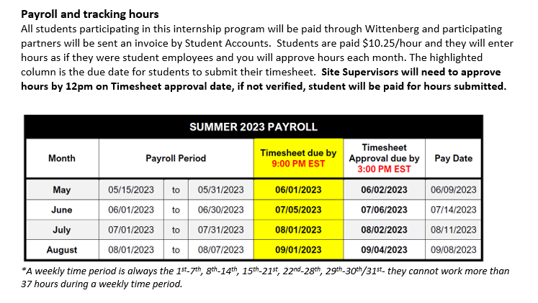
Payroll Timeline
Notes:
We will set up timecards, and ask that you approve hours (may need own system for tracking), and then will be invoiced for appropriate amount each month
Students can’t work over 37 in work week- which is always 1-7, 8-14, 15-21, 22-28, and 29-30/31
Partners billed monthly via email ~10 days after students paid

Slide 11
Guidance for Internship Position Description and Selecting Candidates
Develop an internship position description that meets the needs of your organization and provides students with a meaningful experience.
A good job description includes the organization’s mission, a brief overview of the position, key responsibilities, special qualifications, and specific documents requested.
It is important for interns to understand and participate in the day-to-day operation of the organization. They should be given tasks that help them understand the process and procedure and how their role supports the organization’s mission.
When possible, interns should be given special projects and specific assignments that can be accomplished during the internship.
When interviewing students, try to gauge what special skills and interest you can utilize for these projects.
Research projects and analysis are ideal for interns.
Notes:
Refer to Guidance handout

Slide 12
Questions

