Slide 1



Online Learning at Witt
A workshop for faculty teaching in summer – part II
Sign into Moodle on your device.
Notes:
Michelle opening

Slide 2
Agenda
Use of Big Blue button for synchronous sessions and instructor recordings
Accessibility
Plagiarism
Online teaching tools and techniques
Notes:
Online Summer School Information – Michelle
Review of Moodle Basics – Bryce
Campus Resources – Bryce
Essential Info for every Moodle Course – Barbara
Best Practices in beginning Course Design – Bryce
Instructional Equivalencies – Barbara
Accessibility – Bryce

Slide 3
EPC Questions for Online Learning
Does the course normally rely on discussion, group activities, and other engaged learning practices? If so, how do you intend to approximate that aspect of the class online?
How will you monitor and assure academic integrity in the online course?
How will you make yourself accessible to students for course assistance and advice?
How will you enable and encourage student participation and engagement in the online class?

Slide 4

Review of Big Blue Button
Login to moodle.wittenberg.edu
Look for the "Moodle Online Workshop" course
Please use either the Chrome or Edge web browser
Demonstrate using BigBlueButton
Demonstrate setting up BBB Moodle Course Activity
Notes:
Quick demo?

Slide 5
Review of Big Blue Button
The color of the sky is
Green
Purple
Blue
Red
Notes:
Quick demo?

Slide 6
Accessibility
Headings in Text Editor
Alternate Text for Images
Embed YouTube Videos with Closed Captions Enabled
Instruct Students on How to Use any Required Technology for the Class
Be Willing to Use Time in the First Class for that Technology Instruction
Notes:
Built into the core of Moodle since version 2.

Slide 7

Plagiarism/Cheating
PROBLEM: Students are not knowledgeable on plagiarism, are rushed or are unconcerned with their academics.

Slide 8
Strategies
Identify problem areas in your course
  basic recall assignments,
  assignments that have not changed for a long period of time,
  standard questions from a textbook.
Google your multiple-choice questions. Look for these companies in the results.
  Chega
  Course Hero
  Study Moose
  Test bank service

Slide 9
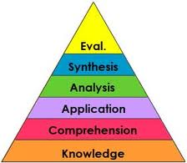
Strategies
Move up on Blooms Taxonomy.
  Ask open ended questions.
  Ask questions with more than one answer.
  Give options on how to answer. Assign a video, collage, mind map.
  Design tests to be open book.
Quizzes
  Shuffle the answers.
  Set a time limit. Enough time to take the quiz but not enough time to look up everything.
  No going back on quizzes.
  Restrict the time when quiz is available.
  “Show correct answers” option can be used, but only alter the due date and turn it off after about a week.
Notes:
Problem areas in courses could be outcomes low on Blooms taxonomy where students just have to recall information or provide the one right answer.

Slide 10

Strategies
Honesty Agreement
Students agree to be honest. Set up a quiz in Moodle where they agree not to cheat. Assign a few points to it. Set it so they cannot continue in course until they answer all three questions.
I have read the syllabus.
I have reviewed the information on plagiarism, and I agree to never plagiarize.
I swear that the work that I submit in this class is my own.
Notes:
Problem areas in courses could be outcomes low on Blooms taxonomy where students just have to recall information or provide the one right answer.

Slide 11

Online Tools and Techniques
Learning Communities
  Useful with a large class
  Instructors assign roles within the LC to encourage active participation of all students. Roles can include:
      facilitator (serves as team leader and key contact to instructor),
      interpreter (reteaches concepts),
      reminder (reiterates assignment criteria and deadlines)
      mentor (review’s peer work and offers professional critique before submission).

Slide 12
Online Tools and Techniques
Job Aids
  Job Aids for all new technology and/or new interactive experiences can direct performance as the need-to-know arises.
Micro learning
Separate concepts can be delivered as online modules.
  Add building blocks as needed, with movement from one concept to the next contingent on an assessment.
Embedded rubrics
  foster open communication and clear expectations.

Slide 13
Useful Tools/Sites
Recorded Powerpoint - using Microsoft instructions
Turn your PP into a video
Screencast-O-Matic – audio and video combined with your PowerPoint
Mind Maps - https://www.mindmup.com/
HippoCampus – video repository
Try using Twitter with your class – you can pre-select links and release them throughout the course. Require 2 or 3 tweets during the course from students.

Slide 14
Instructional Equivalencies
Assignment/Activity | Description | Instructional Hours
Discussion Board | Reading of chapter, viewing of instructor’s recorded PowerPoint, initial post by student, 3 follow-up posts | PowerPoint Viewing = full instructional time Initial post = ½ instruction Follow-up posts = ½ instruction
Big Blue Button live session | Live discussion of weekly topic | 1 hour of participation = 1 hour of instruction
Group Project | Students collaborating using BBB for engagement with one another | 1 hour per week for duration of project
Student Paper based on video | Student views video, also reads or views instructor’s discussion of video | Length of Video = instruction time ½ hour of instructor’s discussion = 1 hour of instruction

Slide 15
Instructional Equivalencies
Assignment/Activity | Description | Instructional Hours
Online quizzes | Informal assessment tool to assess knowledge and provide feedback on progress. | 1 hour test = 1 hour instructional time
Service Learning project | Students required to perform some activity either with other students or not. | 1 hour per week for duration of project
Reflection assignments | Students reflect on course concepts either directly submitted to instructor or shared with others with requirement to comment on others posts. | 1 private submission = ½ hour instruction 1 shared posting (required to read all classmates’ postings) = 1 hour instruction

Slide 16
Instructional Equivalencies
Assignment/Activity | Description | Instructional Hours
Student presentations | Could be done via use of BBB or prerecorded by student, could be shared with classmates with expectation of discussion | Time allotted for presentation = instructional time If shared and students are required to watch classmates, time is calculated based on length of viewing plus ½ instruction
Guided Project | Student is working on a project with regular check-ins with instructor for review. | 1 hour per week for duration of project

Slide 17


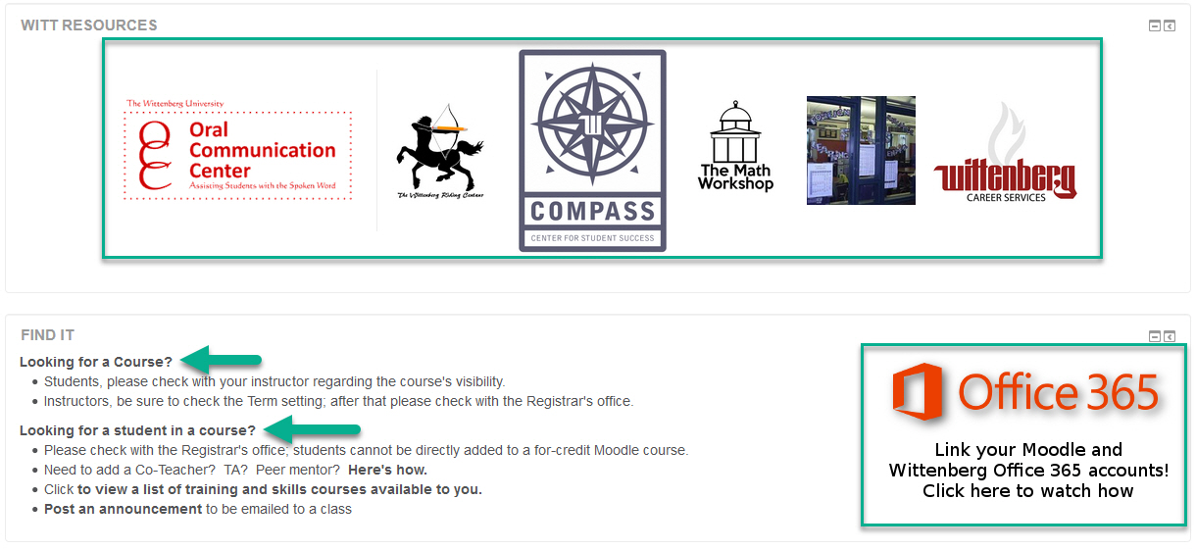
Campus Resources – Moodle
Notes:
Bryce’s planned open lab sessions, online videos Bryce has already done, place to record short lectures
What else?

Slide 18
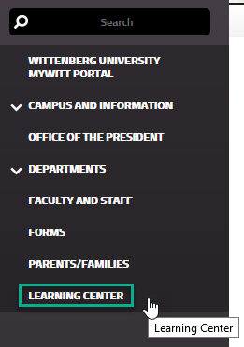
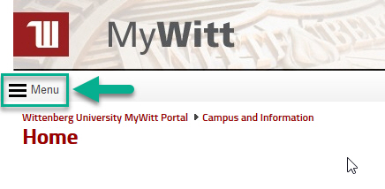
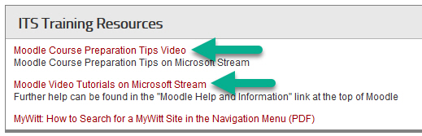
Campus Resources – MyWitt
Notes:
Bryce’s planned open lab sessions, online videos Bryce has already done, place to record short lectures
What else?

Slide 19
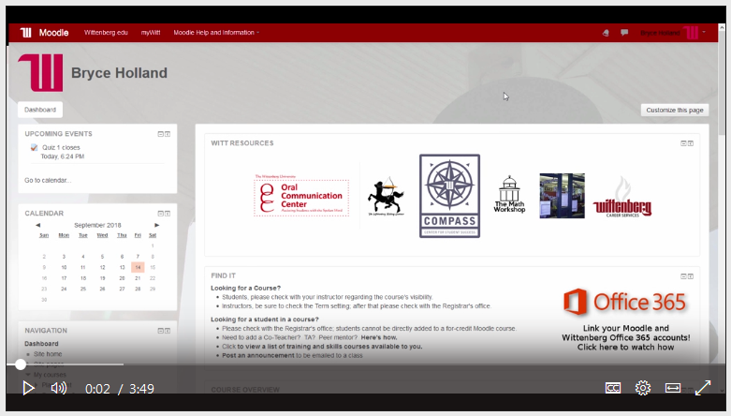
Online Orientation Email for Summer Students
FYI: You are registered for an online summer course!
How to log in to Moodle and find your summer course
Video introduction tutorial
Who to contact for help
Add/drop dates
Academic Honesty Policy
Orientation email will be sent to registered students by Wednesday, May 1. Students will be instructed to log in to their Moodle courses by Thursday, May 9.
Instructors should send a welcome email to students by Thursday, May 9. Introductory activities should be completed by Monday, May 13. (Please notify GPS of students who do not respond to introductory activity.)

Slide 20
Questions???
Bryce Holland
ProStratus IT Project Manager
hollandb@wittenberg.edu
937-525-3807
Wittenberg ITS Solution Center
solution@wittenberg.edu
(937) 525-3801
Barbara Randazzo
GPS Executive Director
randazzob@wittenberg.edu
937-327-7040
Michelle Van Dyke
GPS Director
gaffordm@wittenberg.edu
937-327-7015

