Slide 1
Student Evaluations of Teaching
Tuesday 9/27
4:30pm
Presented by the Teaching Effectiveness Committee:
Amber Burgett, Justin Houseknecht, Wendy Gradwohl, Irene Presper, Olivia MIller

Slide 2
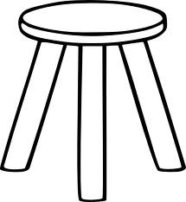
Evaluating Teaching
Student evaluations
Self evaluations
Peer evaluations

Slide 3
Why not the IDEA?
Survey in March 2015 showed that the IDEA was not well understood, liked, or utilized

Slide 4
Why the SEEQ?
Evaluated 6 SETs
  IDEA, SEEQ, SPTE, CIEQ, SIRII, IASystem, & Panorama
  Number of items per domain, applicability to non- lecture courses, & tone
SETs used for
  Personnel decisions
  Teaching improvement
  Program assessment
Notes:
Effective teaching is multidimensional & each dimension should be probed with multiple items
SEEQ, SPTE, CIEQ (Also Panorama & IDEA but not as straight forward )
Lecture- centric- classes are increasingly less lecture- oriented but evals still assume lecture format
SPTE (Also IDEA & SEEQ but probe student-faculty/ student-student interactions, too)
Negative tone- concern of strong emotional response
CIEQ, SPTE
Also informed through our own research
*SET- Student Evaluations of Teaching

Slide 5
Why the SEEQ?
Decision making process
  Reliability
    Similar for IDEA & SEEQ
  Validity
    Stronger for SEEQ
  Customization
    More flexibility
  Reporting
    Quicker for SEEQ
Notes:
4 Factors to compare effectiveness
Reliability & Validity- Gradwohl will go into more detail
Customization- useful for personnel decisions, teaching improvement, & program assessment
Reporting- 1-7 days vs. 6-8 weeks

Slide 6
What is the SEEQ?
8 Dimensions of Learning
Learning
Enthusiasm
Organization
Group interaction
Individual Rapport
Breadth
Examinations
Assignments
Comment section after each dimension
Notes:
SEEQ is broken into 8 dimensions (as listed above) with several questions under each dimension
Covers a broader set of ideas
Comment sections in each topic
Allow for depth to manifest, provided that the student has it

Slide 7
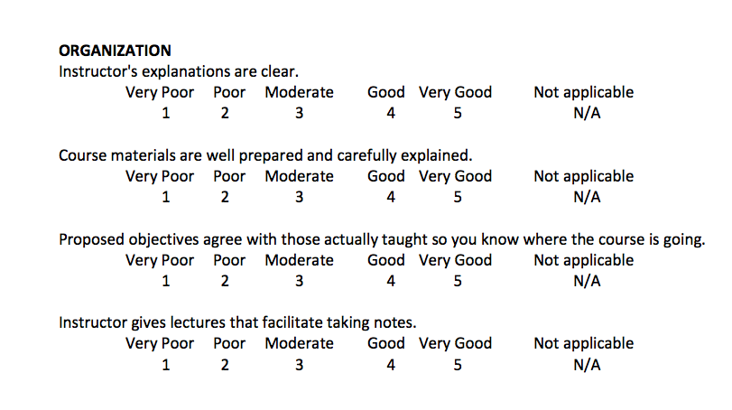
Examples of Dimensions

Slide 8
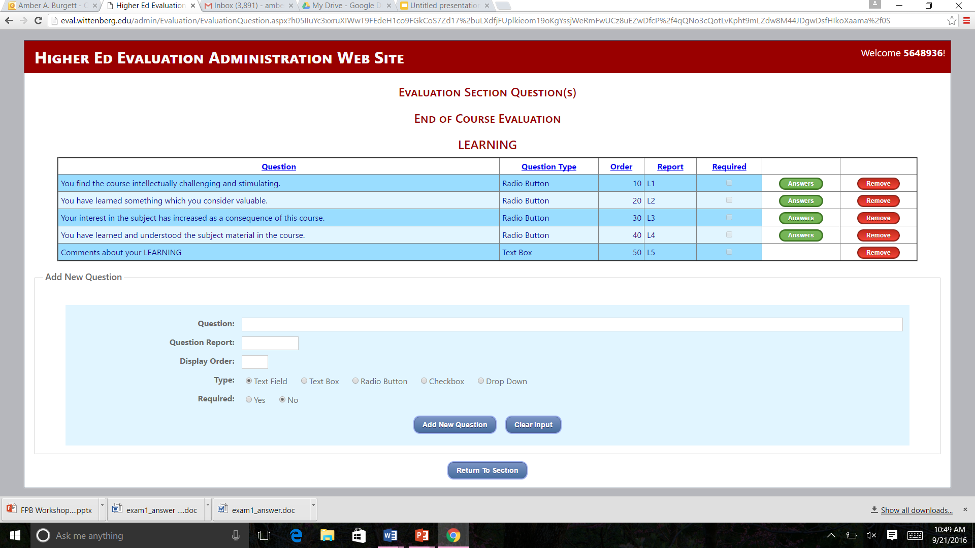
Learning Dimension

Slide 9
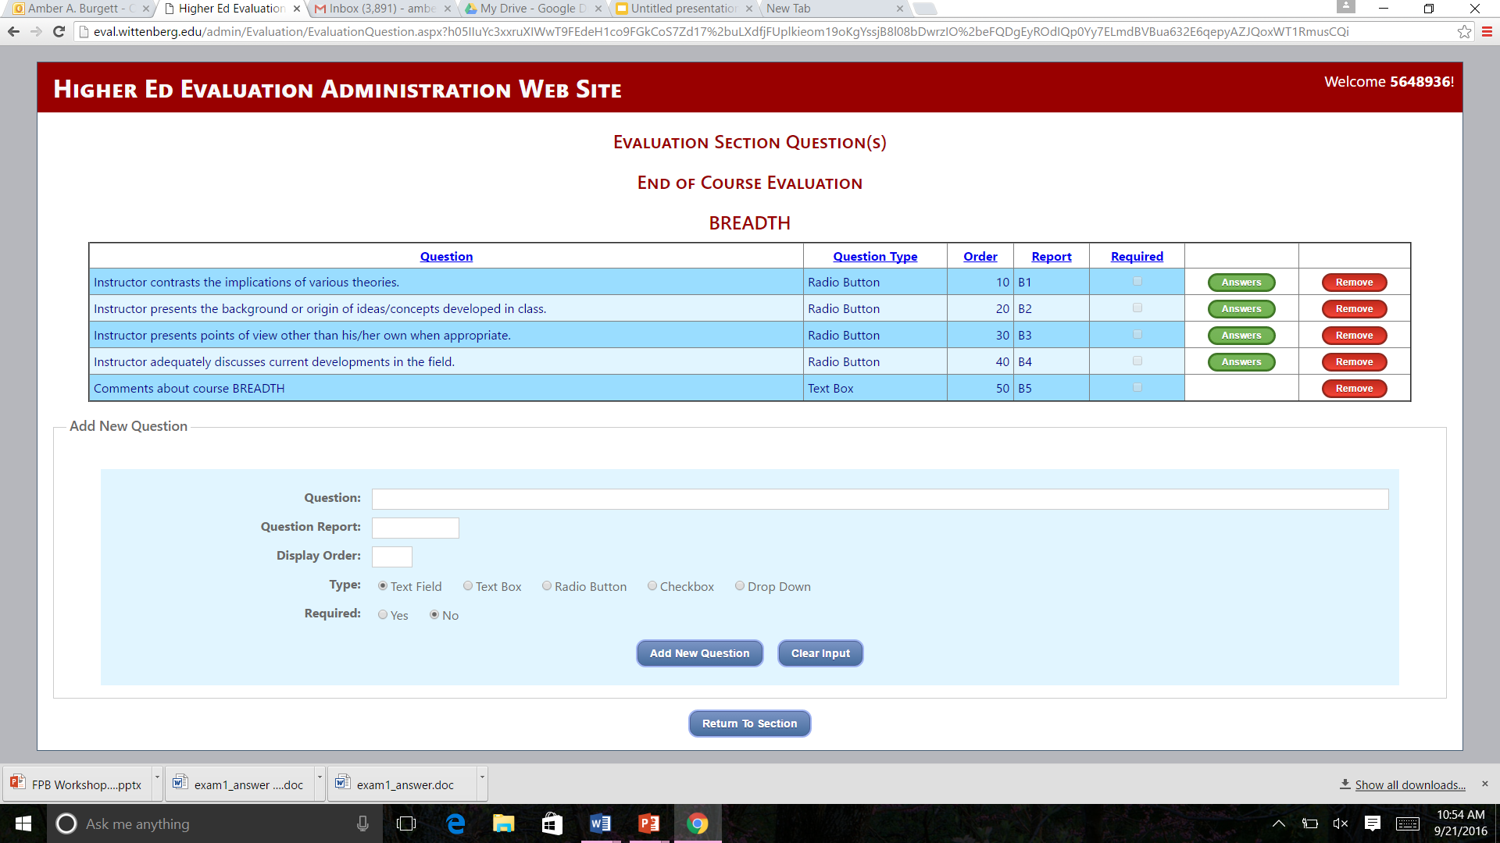
Breadth Dimension

Slide 10
Development of SEEQ
Items based on 19 essential characteristics of a superior college teacher developed by Feldman (1976)
First SEEQ developed at UCLA
Extensive item pool developed based on current practices, interviews with students and faculty, and review of evaluation literature
Pilot surveys with 5-75 items given to classes in various academic departments; students not only evaluated their instructor with the items but were asked to indicate items that were most reflective of quality of teaching and whether there were any items that had been excluded; instructors asked to indicate items that would be most useful in improving their teaching
Four criteria used to select items to be included on the UCLA version of SEEQ: 1) student ratings of item importance 2) staff ratings of item usefulness 3) factor analysis 4) item reliabilities

Slide 11
Reliability Evidence
Reliability
  Intraclass correlation (agreement among ratings within each class) is approximately .90 when ratings are based on 25 or more students v. .74 when ratings are based on only 10 respondents (Marsh, 1987)
  Coefficient alpha (agreement among different items created to measure the same factor) is between .88 and .97.
  Good agreement between responses by current and former students (Marsh, 1987)
Long-term stability
  UCLA study found that students asked to provide retrospective ratings of teaching effectiveness in 100 classes one year after graduation (and several years after taking a course) were correlated .83 with teaching evaluations assessed at the end of the term (Overall & Marsh, 1980).

Slide 12
Validity
Construct validity
  Factor analysis
    Nine factors – based on student as well as faculty ratings from different academic disciplines across years (e.g., Marsh & Overall, 1979b; Marsh 1983, 1984, 1987; Marsh & Dunkin, 1992) and across countries (e.g., Marsh, 1981a)
  Faculty self evaluations
    Correlation between student and faculty ratings on the same factors statistically significant for all factors (median r=.49)
    Held for all levels – undergraduate and graduate
    Multitrait-multimethod analysis – correlations between ratings on different factors were low
Criterion-related validity (i.e., student learning)
  Study in which multiple sections of the same course taught by different instructors (in which students don’t know who will be teaching the section) using the same text, course outline, course objectives, etc. – sections that evaluated teaching most favorably during the last week of classes did better on the standardized exam given to all sections the following week (Marsh et al., 1975; Marsh & Overall, 1980)
  More favorable affective responses to items such as course mastery, plans to apply the skills gained from the course, plans to pursue the subject further correlated with teaching evaluations (Marsh et al., 1975; Marsh & Overall, 1980)
  “former-student and student ratings evidence substantially greater validity coefficients of teaching effectiveness than do self-report, colleague, and trained observer ratings” (p. 195, Howard et al., 1985)

Slide 13
Correlation between dimensional ratings and student achievement
  Structure (.55)
  Interaction (.52)
  Skill (.50)
  Overall course (.49)
  Overall instructor (.45)
  Learning (.39)
  Rapport (.32)
  Evaluation (.30)
  Feedback (.28)
  Motivation (.15)
  Difficulty (-.14)
Example interpretation: Students’ rating of class structure is highly correlated with grade in the class. In other words, students who rated the class structure higher also earned a better grade in the class.

Slide 14
Bias in SETs
No instrument is perfect
Bias does exist in SETs (gender, race, class size, subject matter, etc.)
No tool should be used in isolation
Self evaluations
Student evaluations
Peer evaluations

Slide 15
Logistics of administering the SEEQ
Live 2 weeks before last day of semester
  1st half semester: 10/10/16
  All other fall courses 11/25/16
Closes last day of classes
Reports available 24 hours after grades are due

Slide 16
Accessing student evaluations
Students will receive an email with a link to login page
There will be an evaluations link on the MyWitt homepage
Mobile friendly access through email link or eval.wittenberg.edu
One email and login location for all evaluations

Slide 17
Adding course specific questions
You are also able to access the student evaluations through the evaluations link on MyWitt
Or use eval.wittenberg.edu/admin

Slide 18
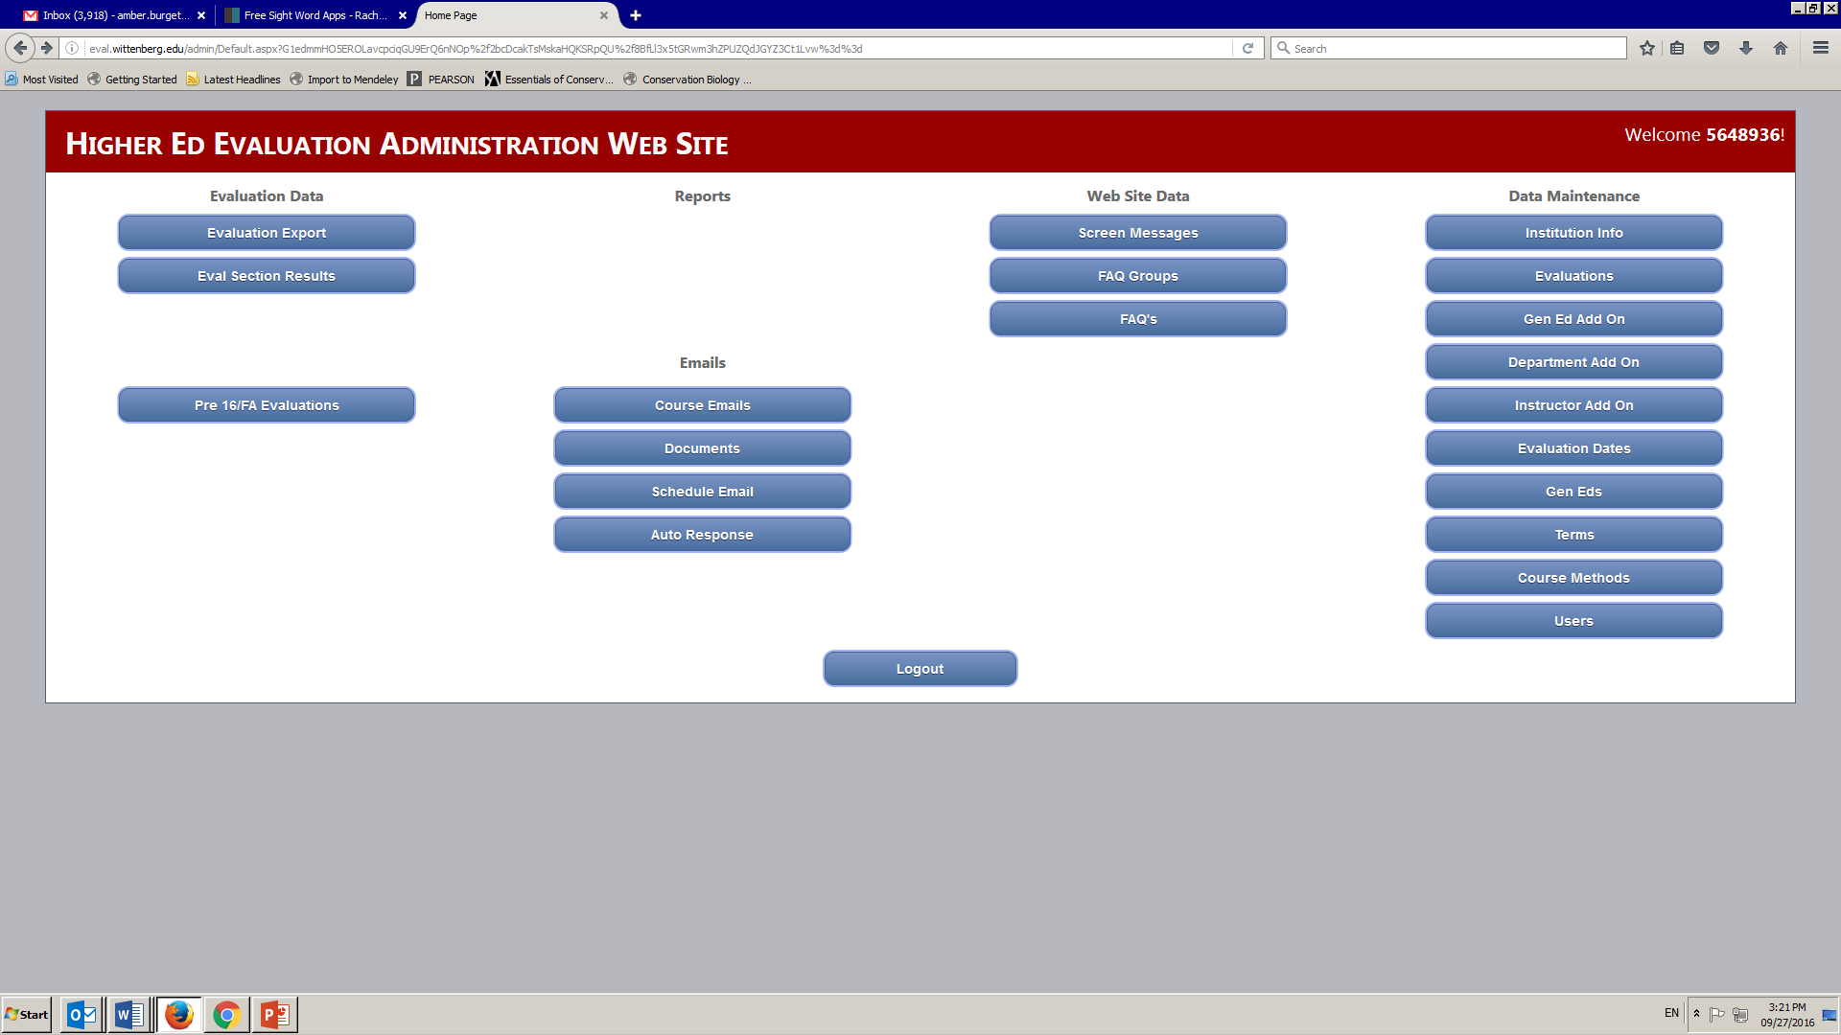
Adding course specific questions
Student evaluations of teaching user manual

Slide 19
Accessing your results
Results will be available 24 hours after final grades are submitted

Slide 20
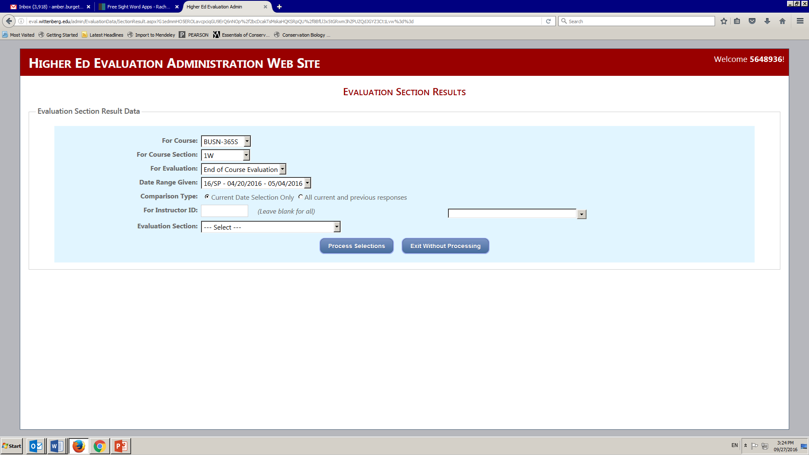
Accessing your results
Choose course

Slide 21
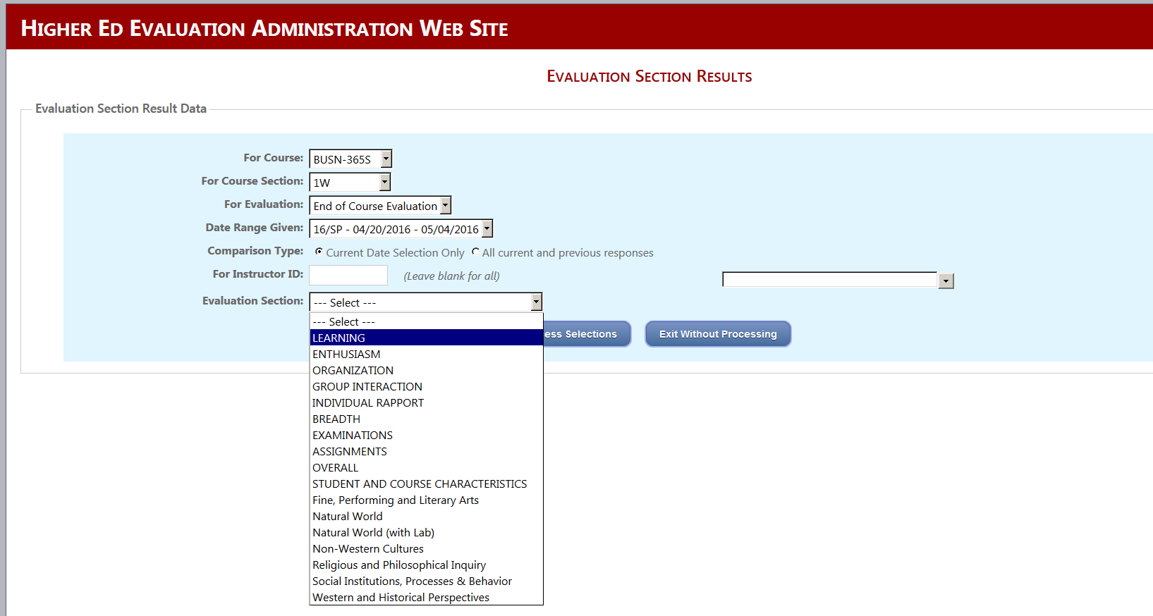
Accessing your results
Choose learning dimension or add on questions

Slide 22
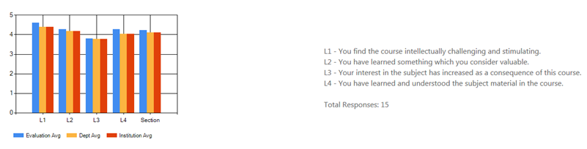
Results for Learning Dimension

Slide 23
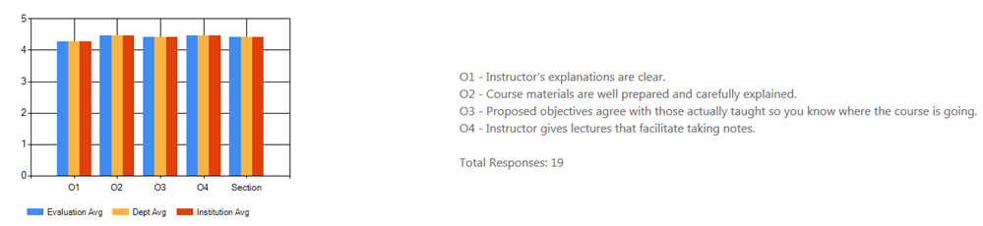
Results for Organization Dimension

Slide 25
Accessing your results
Download raw data using evaluation export

Slide 26
Accessing your results
Reports selections coming soon!
Course summary, tenure prep, and chairs report

Slide 27
Other features
Department specific questions can be added
Access all your evaluation results in one place!

Slide 28
References
Feldman, K.A. (1976). Grades and college students’ evaluations of their courses and teachers. Research in Higher Education, 4, 69-111.
Howard, G.S., Conway, C.G., & Maxwell, S.E. (1985). Construct validity of measures of college teaching effectiveness. Journal of Educational Psychology, 77, 187-196.
Marsh, H.W. (1982). The use of path analysis to estimate teacher and course effects in student ratings of instructional effectiveness. Applied Psychological Measurement, 6(1), 47-59.
Marsh, H.W. (1983). Multidimensional ratings of teaching effectiveness by students from different academic settings and their relation to student/course/instructor characteristics. Journal of Educational Psychology, 75, 150-166.
Marsh, H.W. (1984). Students’ evaluations of university teaching: Dimensionality, reliability, validity, potential biases, and utility. Journal of Educational Psychology, 76, 707-754.
Marsh, H.W. (1987). Students’ evaluations of university teaching: Research findings, methodological issues, and directions for future research. International Journal of Educational Research, 11(3), 253-388.
Marsh, H.W., & Dunkin, M. (1992). Students’ evaluations of university teaching: A multidimensional perspective. In J.C. Smart (ed.), Higher education: Handbook on theory and research, vol. 8, pp. 143-234. New York: Agathon Press.
Marsh, H.W., Fleiner, H., & Thomas, C.S. (1975). Validity and usefulness of student evaluations of instructional quality. Journal of Educational Psychology, 67, 833-839.
Marsh, H.W., & Overall, J.U. (1979b). Validity of students’ evaluations of teaching: A comparison with instructor self evaluations by teaching assistants, undergraduate faculty and graduate faulty. Paper presented at the Annual Meeting of the American Educational Research Association, San Francisco (ERIC Document Reproduction Service No. ED177205).
Marsh, H.W., & Overall, J.U. (1980). Validity of students’ evaluations of teaching effectiveness: cognitive and affective criteria. Journal of Educational Psychology, 72, 468-475.
Overall, J.U., & Marsh, H.W. (1980). Students’ evaluations of instruction: A longitudinal study of their stability. Journal of Educational Psychology, 72, 321-325.

