Slide 1
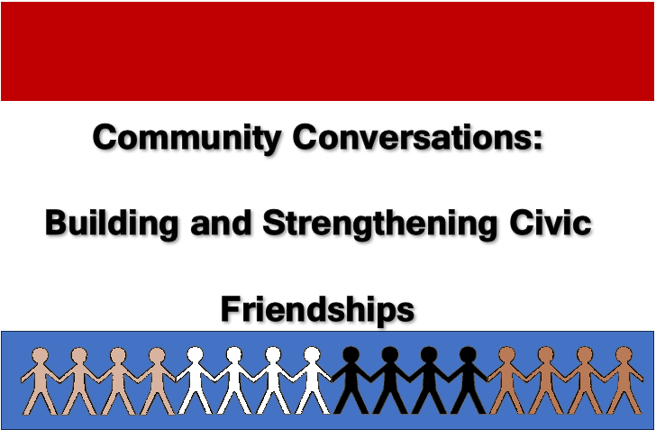
What do Americans Think “good citizenship” means?

Slide 2
Citizenship in Theory:
Russell Dalton’s Work
Aristotle: Citizenship balances two contending roles—citizens are “all who share in the civic life of ruling and being ruled in turn” (Politics, italics added).
So, in a democratic society this conception of citizenship implies 4 aspects:
  Individual Freedom/Autonomy
  Participation in Public/Civic Affairs
  The Authority of the State/Government
  Social Relations with Others

Slide 3
Dalton: What do Americans Think a “Good Citizen” is
2004 General Social Survey asked this:
  “There are different opinions as to what it takes to be a good citizen. As far as you are concerned personally, on a scale of 1 to 7, where 1 is not at all important and 7 is very important, how important is it to . . .” There were several questions related to each dimension.
  Participate
  Be Autonomous
  Adhere to Social Order/Laws/Norms
  Help Others (Solidarity dimension)

Slide 4
Categories of Citizenship
Category | GSS | CDACS
Participation | 1. Always vote in elections 2. Be active in social groups 3. Choose products for political, social, or environmental reasons | Vote in elections Be active in voluntary orgs Be active in politics
Autonomy | Try to understand reasoning of people with other opinions. Keep watch on actions of government | 1. Form opinion independently of others.

Slide 5
Categories of Citizenship
Category | GSS | CDACS
Social Order | Always obey laws and regulations. Never try to evade taxes. Being willing to serve in the military in a time of need. | Always obey the laws and regulations. Serve on a jury if called. Men serve in the military when the country is at war. 4. Report a crime that one may have witnessed.
Solidarity | Support people in America who are worse off. Help people in the rest of the world who are worse off. | 1. Support people who are worse off than oneself.

Slide 6
Dimensions of Democratic Citizenship—GSS Factor Analysis
Survey Question | Duty-Bound Citizen | Engaged Citizen
Vote in Elections | .65 | .17
Never evade taxes | .65 | -.01
Serve in the Military | .54 | .07
Obey the Law | .51 | .10
Keep Watch on Gov’t. | .51 | .40
Active in Associations | .39 | .54
Understand Others | .28 | .59
Choose Products | .22 | .59
Help Worse off in World | -.12 | .77
Help Worse off in America | .02 | .77
Eigenvalue | 1.95 | 2.37
Percent Variance | 19.5% | 23.7%

Slide 7
Dimensions of Democratic Citizenship—CDACS Analysis
Variable | Duty-Bound Citizen | Engaged Citizen
Report a Crime | .84 | .12
Always Obey the Law | .77 | .09
Serve in the Military | .64 | .15
Serve on a Jury | .63 | .32
Vote in Elections | .56 | .43
Form Own Opinions | .29 | .47
Support Worse Off | .16 | .65
Be Active in Politics | .15 | .80
Active in Voluntary Orgs | .10 | .84
Eigenvalue | 2.56 | 2.37
Percent Variance | 28.5% | 25.8%

Slide 8
Findings are Consistent Across time and Surveys
Dalton repeated these analyses with 2014 and 2018 Data
Same Results—Is this good for knowledge?

Slide 9
Who Are the “Duty-Oriented” v. “Engaged-Oriented”
Duty-Oriented
  White
  Men
  More religious
  Older
  Conservatives
  Republicans
  Non-college
  Lower income
Engaged-Oriented
  Minority (non-Asian)
  Women
  Less religious
  Younger
  Liberals
  Democrats
  College-educated
  Higher income

Slide 10
Social Groups and the Two Dimensions of Citizenship--2004
0.5
Engaged 0
-0.5
-0.5 Duty-Bound 0.5
*Nader Voters *African Americans *Gen X *Dems *Non religious | *Other races *Graduate Degree *Religious *Women
Independents* <Less than HS* | *Whites *Men *Republicans Pre WWII*

Slide 11
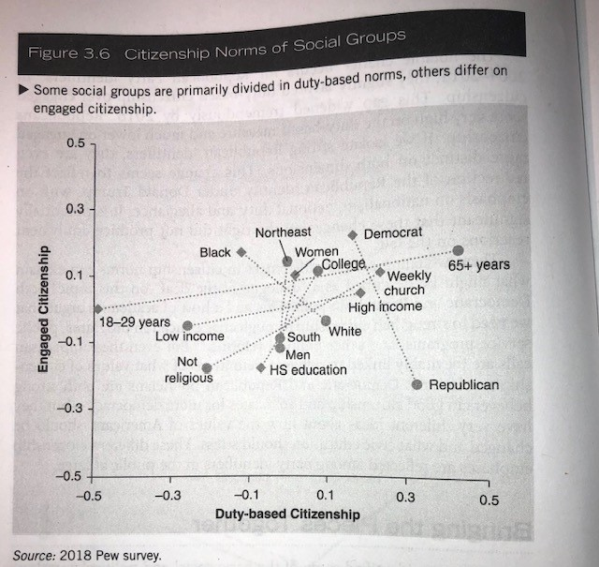
Social Groups and the Two Dimensions of Citizenship—2018

Slide 12
How Does Citizenship Orientation Affect Behavior and Attitudes?
Political Participation
  Duty-Bound: Less likely to engage in non-electoral forms of participation, e.g., protests, boycotts, writing letters/contacting politicians, contributing $, working in campaigns.
  Engaged: More likely to do the above

Slide 13
How Does Citizenship Orientation Affect Behavior and Attitudes?
Political Tolerance of Marginalized Groups (Communists, Atheists, Militarists, Homosexuals, and Racists). Question Asked: Do you agree that ___ should be allowed to:
  1. Speak in your community?
  2. Teach in a college of university?
  3. Have their books in the local library?
  Duty-Bound: Less tolerant of the above
  Engaged: More tolerant of the above

Slide 14
How Does Citizenship Orientation Affect Behavior and Attitudes?
View/Evaluations of Government
  Duty: Tend to be more supportive
  Engaged: Tend to have mixed views
Support for Democratic Principles
  Duty: Less support for the importance of democratic principles
  Engaged: More supportive
View of How Well the Political System is Living up to these Democratic Principles
  Duty: View performance of democracy as living up to the principles
  Engaged: Sees political system coming up short on living up to the principles

Slide 15
Sources
Dalton, Russell J. 2021. The Good Citizen, 3rd Edition. Washington, D.C.: Sage, CQ Press.
Dalton, Russell J. 2009. The Good Citizen, Revised Edition. Washington, D.C.: Sage, CQ Press.
Dalton, Russell J. 2006. “Citizenship Norms and Political Participation in America: The Good News Is . . . the Bad News is Wrong.” The Center for Democracy and Civil Society Occasional Paper Series, Georgetown University (CDACS Occasional Paper 2006-01, October).

