Slide 1
Wittenberg University
Preventive Care Workshop
Anthem Benefits, Resources, and Value-Adds
Notes:
Open Enrollment 2016
Connecting you to quality health plan options

Slide 2

Program Highlights
Health & Well-being Series
Lunch & Learn February 21, 2020
Topic: Getting the Most Out of Your Preventive Benefits
Your health is up to YOU. The actions you take now can help you feel better in the present and influence your future health and well-being. By taking control of your health, you can prevent medical conditions like heart disease, diabetes and cancer from developing. Join as we discuss how to get the most out of your Preventive benefits through Anthem Blue Cross/Blue Shield and learn more about finding a Primary Care Physician, special discounts, and the new Sydney app!

Slide 3

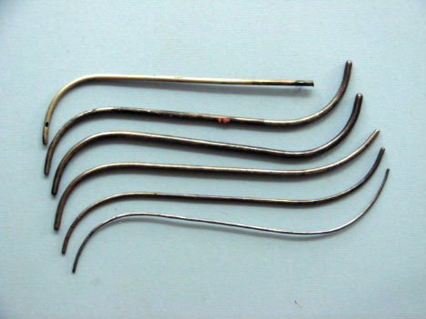
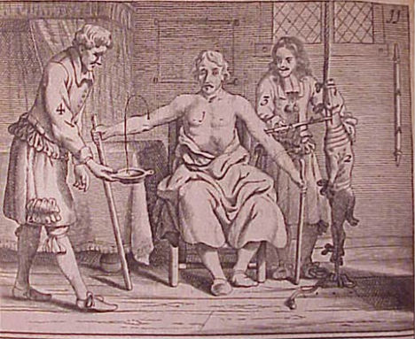

History Lesson!

Slide 4
Fast Forward…Where are We Today with Health & Well-being Options?
Consumer engagement is key to transforming health care.

Slide 5

How Many Will We Purchase in a lifetime?
Cars
TV
Homes
Children
6
7
3
2.5
5
Notes:
Claims data based on Local Group and Ind, Non Refunding Members only, for LHO fully treatable diagnosis codes in WLP’s 14 Blue states.”

Slide 6

How Many Will We Get in a Lifetime?
6

Slide 7


Step 1: Prevention!
Finding a Personal Physician
Look for Enhanced Personal Health Care Practices
“Never go to a doctor whose office plants have died”…Erma Bombeck

Slide 8



How Enhanced Personal Health Care Benefits the Patient
We’re taking a revolutionary team-based approach to managing care, providers and data. So patients don’t fall through the cracks.
Doctor-RN team to coordinate care
Health assessments and personalized care plans
Referrals to behavioral health providers
Data coordination
Help with diet, weight management and smoking cessation
RN case manager to monitor progress
Exams, screenings and immunizations
8
Notes:
Patients Receive:
A health assessment and personalized care plan
A referral to a behavioral health provider
Medication coordination
Help with diet, weight management and smoking cessation
An RN case manager to follow-up and monitor progress
Support scheduling exams, screenings and immunizations
This approach:
Steers way from unnecessary hospital and ER visits in favor of outpatient solutions.
Directs from brand to generic prescriptions, when possible.
Motivates to actively manage health, instead of reacting to crises.

Slide 9
Preventive Care
Did You Know Preventive Care is not subject to the Deductible or Copays!
Adult Exam, Lab and Radiology
Child Exam, Lab and Radiology
Routine Prostate Screening
Routine Pap Smear and Mammograms (3D is covered)
Routine Child Immunizations
Providers must bill Anthem as Preventive in order for services to be covered at 100%. If the claim is diagnostic, then the service will be subject to the deductible and copays.

Slide 10

Meet Kate, 31 years old.
Visited the ER 27 times in the past 12 months
Stopped seeing her psychiatrist
Suffers from a number of conditions
Doesn’t take medications when she should
Enter Enhanced Personal Health Care.
Case Management helps her know when it’s appropriate to use the ER and to find a new psychiatrist
Care coordinates with PCP to assists with her specialty providers
PCP practice establishes rounds to address medication and appointment adherence
Kate gets healthy.
No longer using the ER for non-emergencies
Working with a new therapist
Addressing her health issues in a proactive manner
Taking her medications on time
Notes:
Kate is 31. She's visited the ER 27 times in the past 12 months. Her readmission risk score is 40% based on key risk drivers, including prescription non-compliance and high medical care utilization.
She is engaged in our Case Management program, and a preliminary review of her information confirms a number of conditions including diabetes, allergies, obesity and seizure disorder. We also learn that she no longer sees her psychiatrist because she owes him money.
Care coordination included getting the member connected with her specialty providers. This included coordination with endocrine, neurology, psychiatry and follow-up with her PCP to address medication adherence and reconciliation. Missed appointments were rescheduled immediately.
We refer her to an Anthem social worker for assistance with her financial concerns and frequent ER visits, helping her understand when it's appropriate to use the ER and when she can seek other care. We also coordinate with her specialty providers to address her medication adherence and reschedule missed appointments.
The physician champion at this practice arranged for multi-disciplinary rounds to address this member’s gaps in care.
After addressing several gaps in care, we help Kate get back on track. She's working with a new therapist, taking her medications on time and addressing her health issues in a proactive manner. She is able to return to work without restrictions.

Slide 11



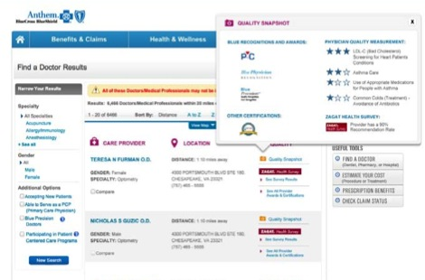

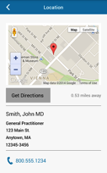
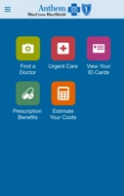
Find a doctor
Selecting providers you know and trust
    Easy-to-use search functions allow members to find the care they need
    Quality Snapshot highlights patient satisfaction and quality information as factors in decision-making
Notes:
We want members to make informed health care decisions. That’s why we’re empowering them, as consumers, with tools to help them shop for value and make informed comparisons on coverage, cost, quality and patient satisfaction.
For example, our Find a Doctor tool lets members search for providers in eight categories, including health care professionals, facilities, dental and vision. It includes search, map and view network provider details.
They can rank providers on quality, through our Blue Distinction National Centers of Excellence Program and Blue Precision Specialty Physician Recognition Program.

Slide 12
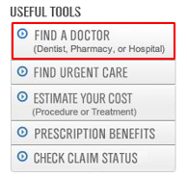

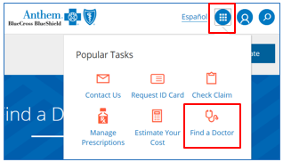
How to Find a Provider
Log in to your account and click Find a Doctor
-OR-
Go to anthem.com
In the quick links menu, select Find a Doctor
Under the Guest section, click Continue
Select the following options:
  You get insurance THROUGH MY EMPLOYER
  Choose your STATE
  You are searching for MEDICAL CARE
  Your plan/network is NATIONAL PPO (BlueCard PPO)
Click Continue

Slide 13
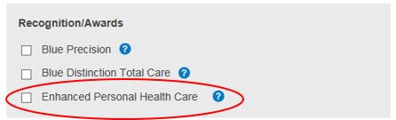
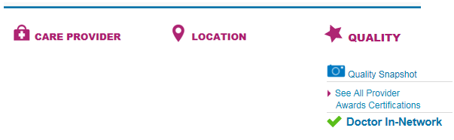

Provider Search Information
Care Provider
  Gender, Languages Spoken, Education, Specialties
  Affiliations
  Locations
Satisfaction & Quality
  Recognition
  Awards
  Certifications

Slide 14


Anthem’s Plan Includes:
Anthem’s plan includes:
  Access to one of the nation’s largest networks of doctors
  Prescription drug coverage with money-saving mail service
  Free preventive care, like annual checkups and vaccinations
  Health and wellness tools that help you get the most out of your plan

Slide 15


Prescription Drug Plan
Save money
Ask your doctor if there’s a generic equivalent for the brand-name medications you’ve been using
Participate in pharmacy generic Rx sales
  Many retail chains offer discount generic drug programs where you can receive certain medications for a discount price of around $4 for a 30-day supply or $10 for a 90-day supply.
Get a 90-day supply of maintenance drugs via mail for less money than if purchased at a pharmacy
  Go to anthem.com. Choose Manage Your Prescriptions on the home page and log in, then choose Switch to Home Delivery.
  Call us 24/7 at 1-866-216-5449.
Save time
Refill your prescriptions online or over the phone
Take advantage of home delivery

Slide 16

Step 2: Know How to Find Tools & Resources
Notes:
Before we wrap things up, we have a few tips that can help you save money.

Slide 17



Introducing LiveHealth Online
Doctor’s care at the speed of life.

Slide 18


Visit with a doctor online, anytime. From work, at home or on the go.
LiveHealth Online:
Is available 24 hours a day, 7 days a week, 365 days a year
Is available anywhere you have a computer or mobile device with Internet access (at home, in the office or on the go)
Provides access to in-network, board-certified doctors
Allows doctors to ePrescribe utilizing local pharmacies (where applicable)
Is secure, convenient and easy-to-use
For H.S.A Plans, while you are in your deductible phase, the cost of the visit is $49.00. PPO Plans the cost of the visit is $20.00 -$25.00 depending upon which plan you are enrolled in.
Psychology and Therapy visits available as well
Easier and less expensive than urgent care

Slide 19



Three steps and you’re face-to-face with a doctor
Once registered, getting started with LiveHealth Online is a breeze. Using LiveHealth Online is a covered benefit, paid at an “in-network” level.
1
Sign up
2
Choose a doctor
3
Begin consultation
Who has time to figure things out?

Slide 20
LiveHealth Online Common Medical Conditions
Doctors consult with patients 24/7 on a variety of conditions, such as:
Fever
Sore throat
Cough and colds
Flu
Urinary tract infections
Sinusitis
Allergies
Eczema, rashes and skin lesions
Heartburn

Slide 21

We make it easy to make smart choices. Register on anthem.com to:
Search for providers
Check your claims
Estimate your costs
Review your medical benefits
View your ID card
Refill a prescription

Slide 22
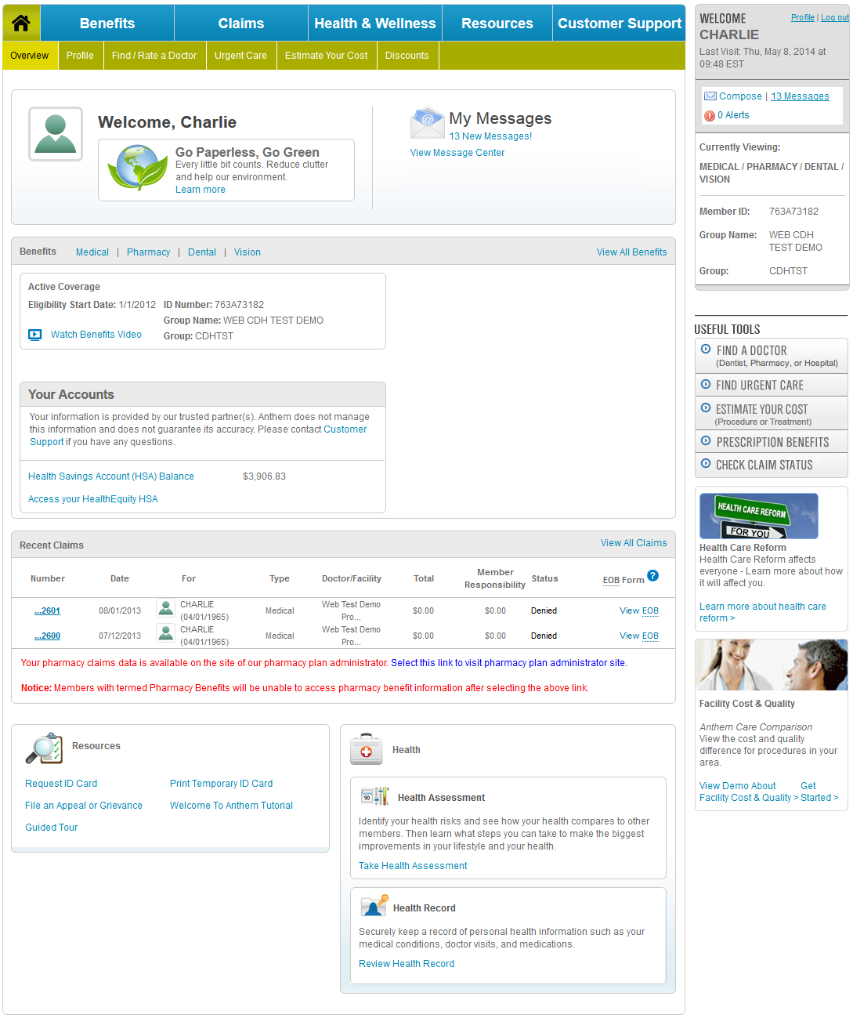
Anthem.com – Easy access to popular tools
Message
Center
Eligibility & Benefits
Quick
Links
Account
Information
Healthcare
Reform
Recent
Claims
Tools &
Resources
Clinical
Tools

Slide 23
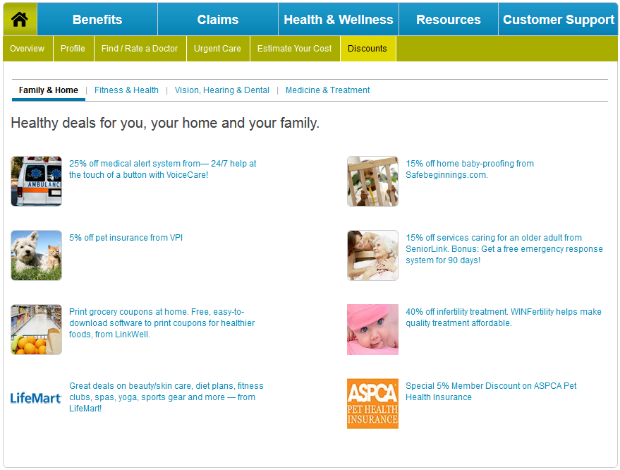
Special Discounts
Healthy deals for you, your
home and your family:
Family & Home
Fitness & Health
Vision, Hearing & Dental
Medicine & Treatment

Slide 24


Step 3: Embrace Technology and Download the New App!
Meet Sydney

Slide 25
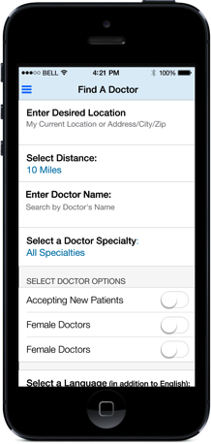
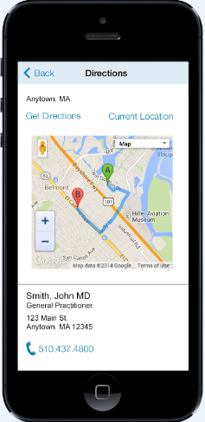
Stay Connected
Download Sydney
the new Anthem
Mobile App to:
  Look up a doctor, pharmacy or urgent care center
  View doctor profile and read patient reviews
  View your Member ID Card

Slide 26
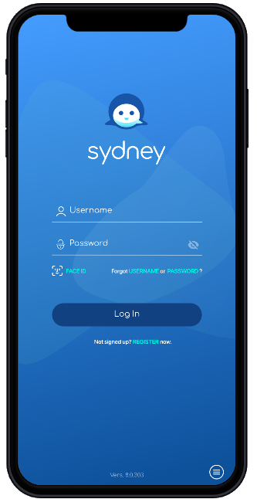
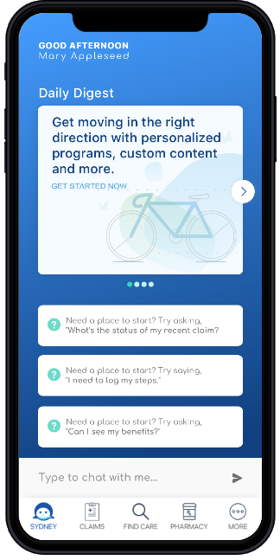
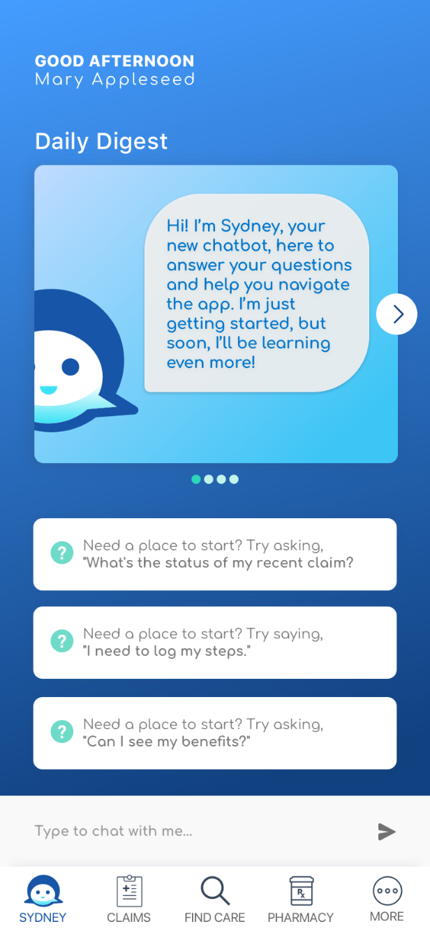

Getting Started – Sign-on
Notes:
Intro for employers and brokers: At Anthem, we had a question: what if we could re-engineer health care from the ground up? What would it look like to take a disjointed and complicated system and make it more connected? It’s a future we can see clearly, because we’re building it right now: a health ecosystem. A thriving, interconnected environment fed by data and digital technologies. Where technology makes the human experience more cohesive. In this kind of health ecosystem, every aspect of health care—doctors, health plans, wellness tools, everything—works together seamlessly to create a more connected experience for everyone. It’s all part of serving each member as a population of one.
Intro for members: Say hello to a simpler health care experience. With Sydney, it's easier to get things done. Use the app to help you find the right doctor. Get the health plan info you need. See all your benefits in one place. And discover new ways to get care, wherever you are. It’s all part of bringing care closer to you in the simplest way possible.

Slide 27
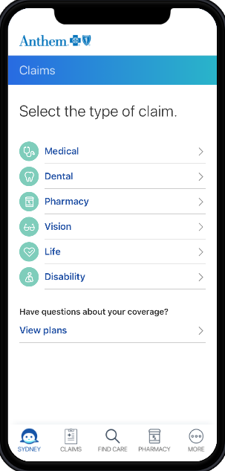
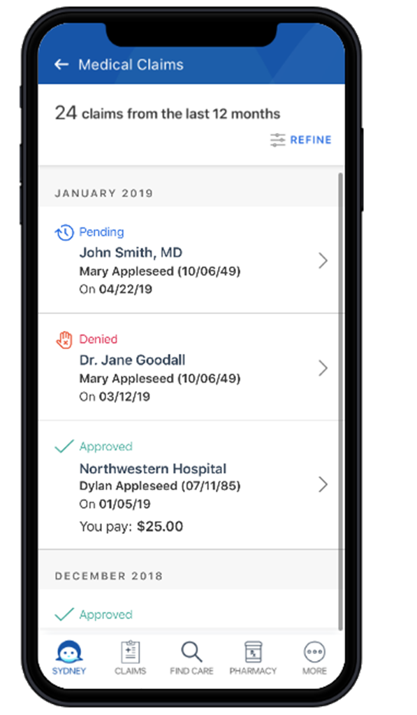
Click on Claims
Notes:
Intro for employers and brokers: At Anthem, we had a question: what if we could re-engineer health care from the ground up? What would it look like to take a disjointed and complicated system and make it more connected? It’s a future we can see clearly, because we’re building it right now: a health ecosystem. A thriving, interconnected environment fed by data and digital technologies. Where technology makes the human experience more cohesive. In this kind of health ecosystem, every aspect of health care—doctors, health plans, wellness tools, everything—works together seamlessly to create a more connected experience for everyone. It’s all part of serving each member as a population of one.
Intro for members: Say hello to a simpler health care experience. With Sydney, it's easier to get things done. Use the app to help you find the right doctor. Get the health plan info you need. See all your benefits in one place. And discover new ways to get care, wherever you are. It’s all part of bringing care closer to you in the simplest way possible.

Slide 28
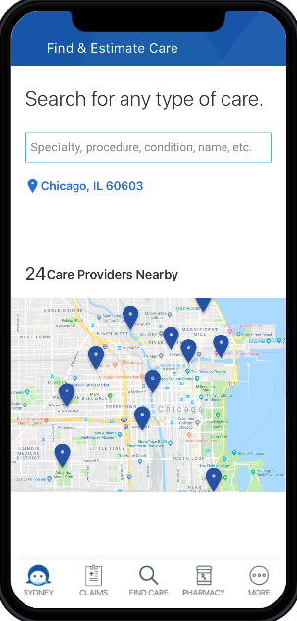
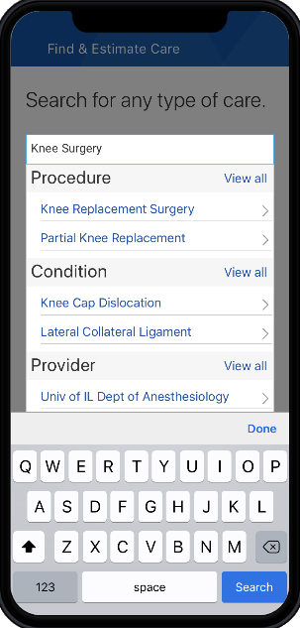
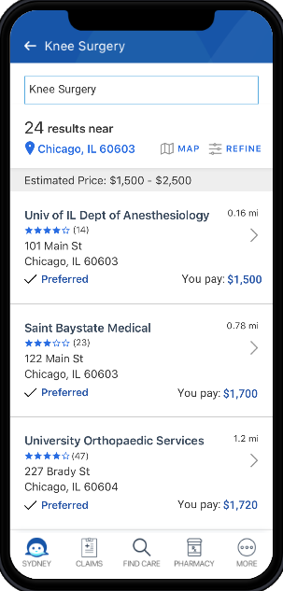
Click on Find Care
Notes:
Intro for employers and brokers: At Anthem, we had a question: what if we could re-engineer health care from the ground up? What would it look like to take a disjointed and complicated system and make it more connected? It’s a future we can see clearly, because we’re building it right now: a health ecosystem. A thriving, interconnected environment fed by data and digital technologies. Where technology makes the human experience more cohesive. In this kind of health ecosystem, every aspect of health care—doctors, health plans, wellness tools, everything—works together seamlessly to create a more connected experience for everyone. It’s all part of serving each member as a population of one.
Intro for members: Say hello to a simpler health care experience. With Sydney, it's easier to get things done. Use the app to help you find the right doctor. Get the health plan info you need. See all your benefits in one place. And discover new ways to get care, wherever you are. It’s all part of bringing care closer to you in the simplest way possible.

Slide 29
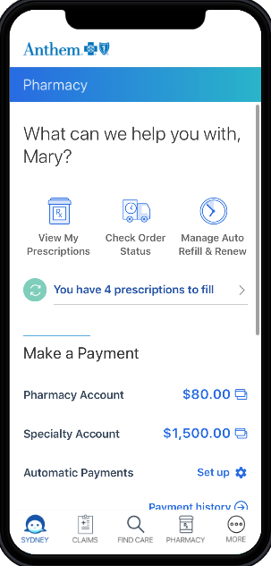
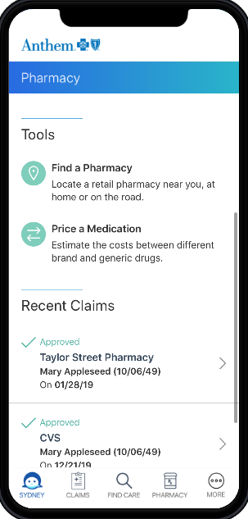
Click on Pharmacy
Notes:
Intro for employers and brokers: At Anthem, we had a question: what if we could re-engineer health care from the ground up? What would it look like to take a disjointed and complicated system and make it more connected? It’s a future we can see clearly, because we’re building it right now: a health ecosystem. A thriving, interconnected environment fed by data and digital technologies. Where technology makes the human experience more cohesive. In this kind of health ecosystem, every aspect of health care—doctors, health plans, wellness tools, everything—works together seamlessly to create a more connected experience for everyone. It’s all part of serving each member as a population of one.
Intro for members: Say hello to a simpler health care experience. With Sydney, it's easier to get things done. Use the app to help you find the right doctor. Get the health plan info you need. See all your benefits in one place. And discover new ways to get care, wherever you are. It’s all part of bringing care closer to you in the simplest way possible.

Slide 30
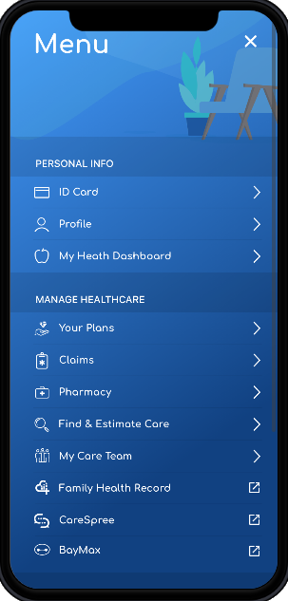
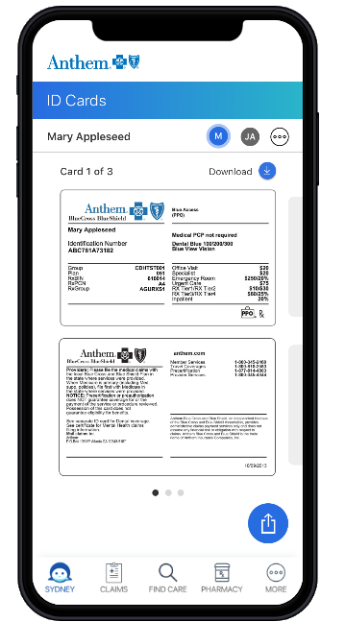
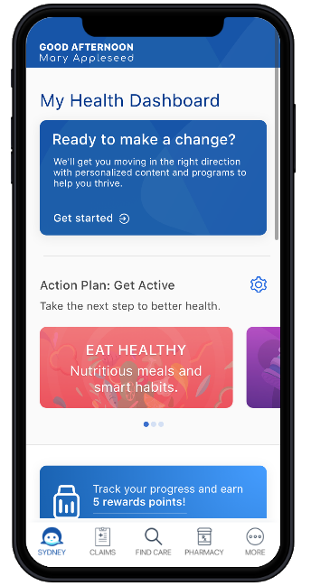
Click on More
Notes:
Intro for employers and brokers: At Anthem, we had a question: what if we could re-engineer health care from the ground up? What would it look like to take a disjointed and complicated system and make it more connected? It’s a future we can see clearly, because we’re building it right now: a health ecosystem. A thriving, interconnected environment fed by data and digital technologies. Where technology makes the human experience more cohesive. In this kind of health ecosystem, every aspect of health care—doctors, health plans, wellness tools, everything—works together seamlessly to create a more connected experience for everyone. It’s all part of serving each member as a population of one.
Intro for members: Say hello to a simpler health care experience. With Sydney, it's easier to get things done. Use the app to help you find the right doctor. Get the health plan info you need. See all your benefits in one place. And discover new ways to get care, wherever you are. It’s all part of bringing care closer to you in the simplest way possible.

Slide 31
Can you answer?
What is the name of the Telehealth benefit? (Hint: It is where you can connect with a doctor on your phone!)
Where can you estimate the cost of a procedure?
Is the cost of an annual preventive visit free?
I'm interested in buying some contact lenses and checking out discount gyms…where do I go?
What is the name of the Anthem App?
Thank you for attending!

